Slide 1
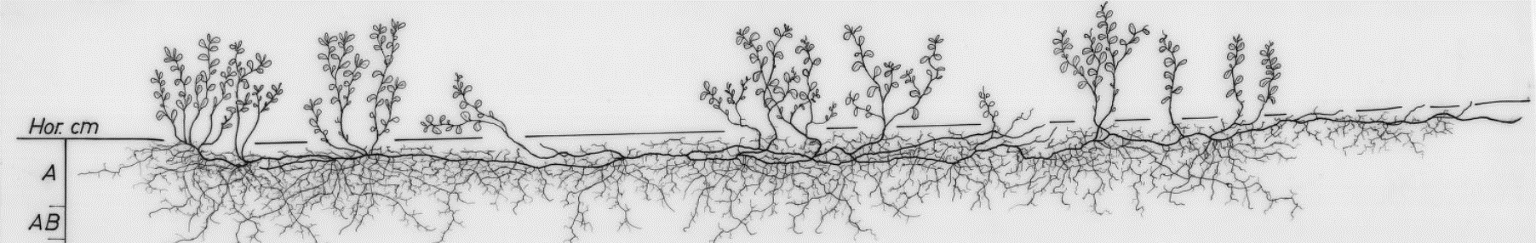
Spatial & Temporal Root Dynamics
Johannes Cunow
Department of Ecology and Environmental Science
Feb. 2024

Slide 2
Questions
When and where do roots grow?

Slide 3
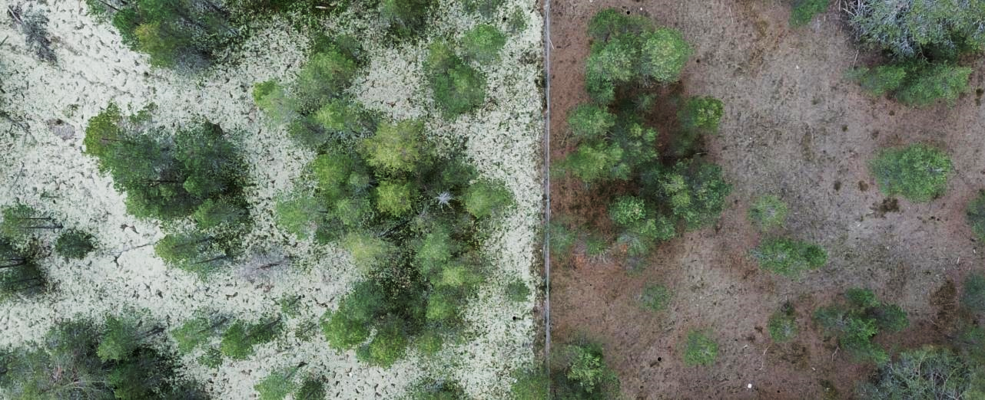
Ongoing Projects
&
New Ideas

Slide 4
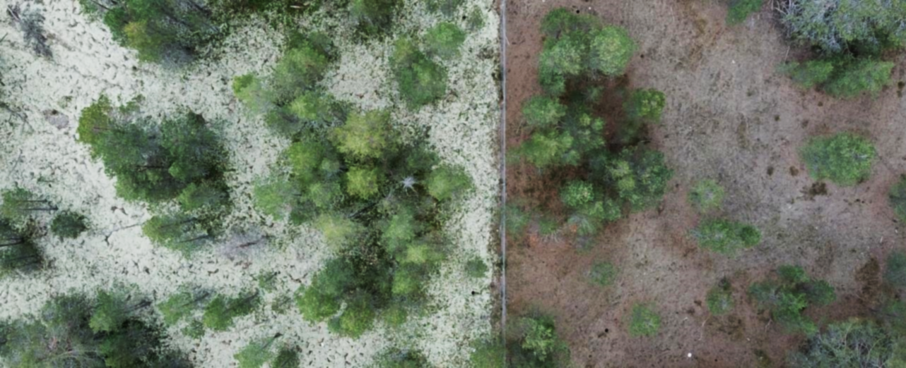
Reindeer Grazing – a Spatial Root Response

Slide 5
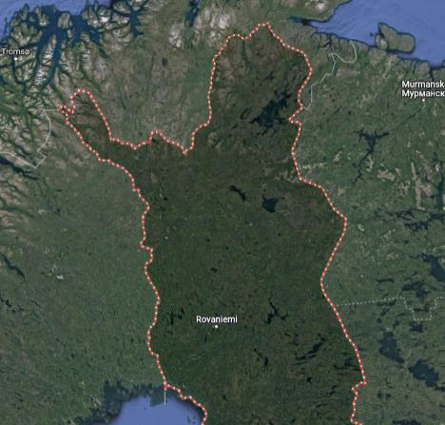
Reindeer Exclosures >50 y (Border Fences)
Angeli
Raja-Jooseppi
Kätkäsuvanto

Slide 6
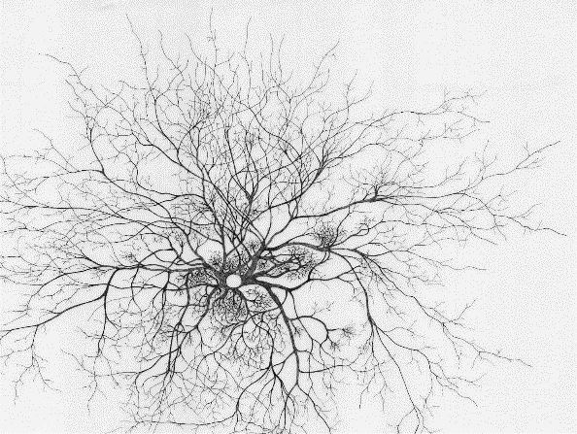
Horizontal Vertical
0-5 cm
3 m
2 m
5-10 cm
1 m
10-15 cm
15-20 cm
20-25 cm

Slide 7
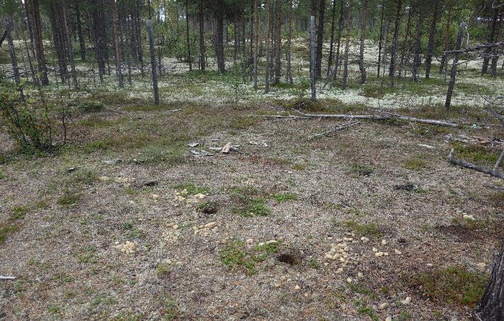
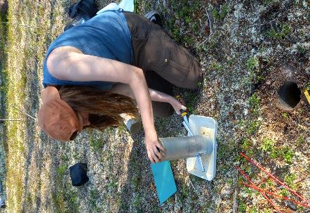
Sampling Process
3m
2m
1m

Slide 8
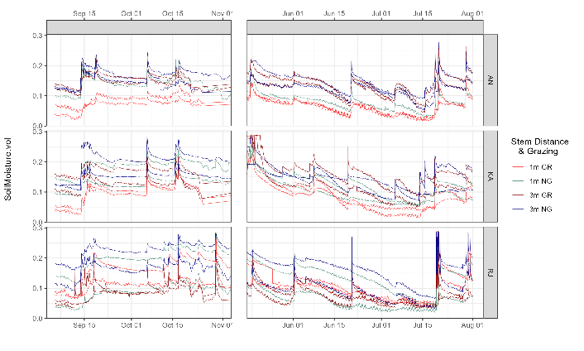
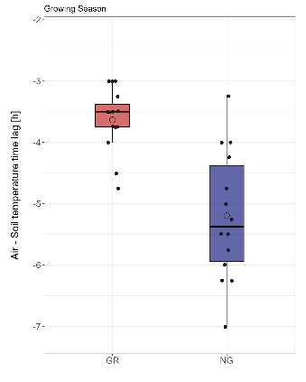
Soil Climate

Slide 9
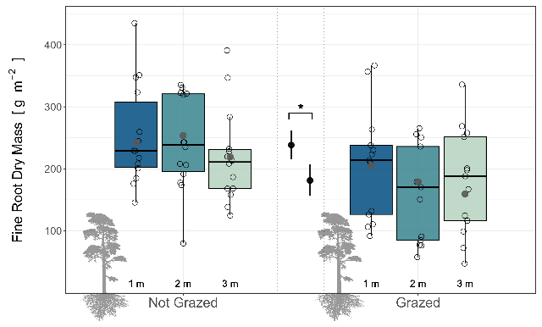
Horizontal Homogeneity

Slide 10
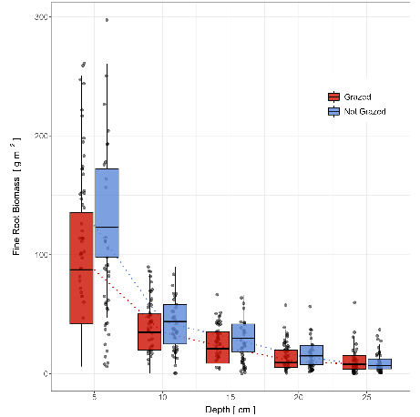
Vertical Shift

Slide 11
Questions
Whats the influence of
snow cover and grazing
on roots?

Slide 12
Questions
What are the implications of spatial-temporal patterns?

Slide 13
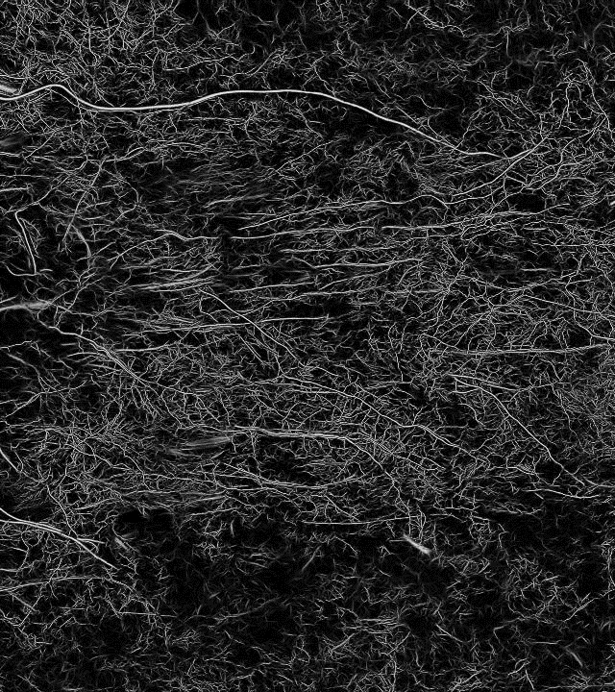
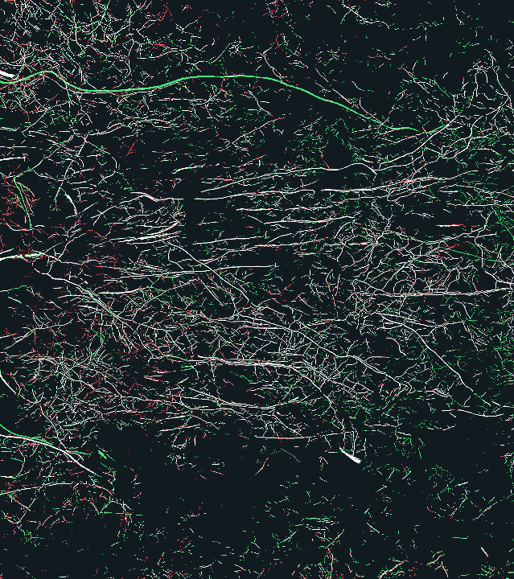
Our Projects in Oulanka

Slide 14
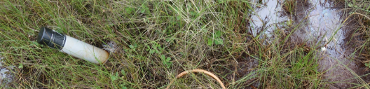
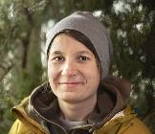
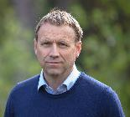




Minirhizotrons and Us
Gesche Blume-Werry
Johan Olofsson
Maria Väisänen
Johannes Cunow

Slide 15

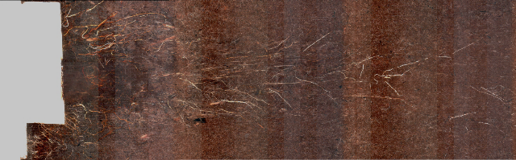
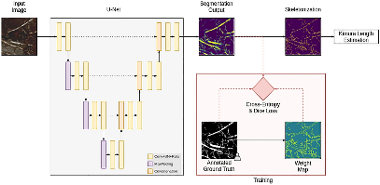
AI Magic ✨
Peters et al. 2023

Slide 16

Depth Mapping
Top
upside
?
downside
Bottom

Slide 17
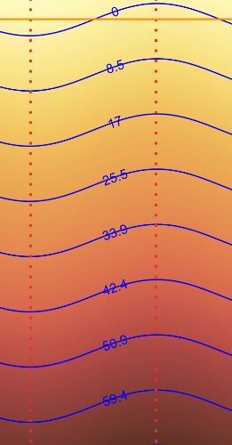
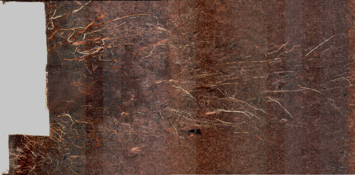
Continuous Depth

Slide 18
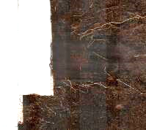


Temporal Comparison – Turnover/Phenology
t₁
When?
t₂
Turnover

Slide 19

Temporal Comparison – Spatial Hotzones
t₁
When?
Where?
t₂
Turnover

Slide 20

Root Dynamics between years and seasons

Slide 21






Multi-Year Dataset (Fen & Forest)
Snow x Grazing x Interannual Variability affects Distribution and Turnover?
2020
2021
2025
...

Slide 22
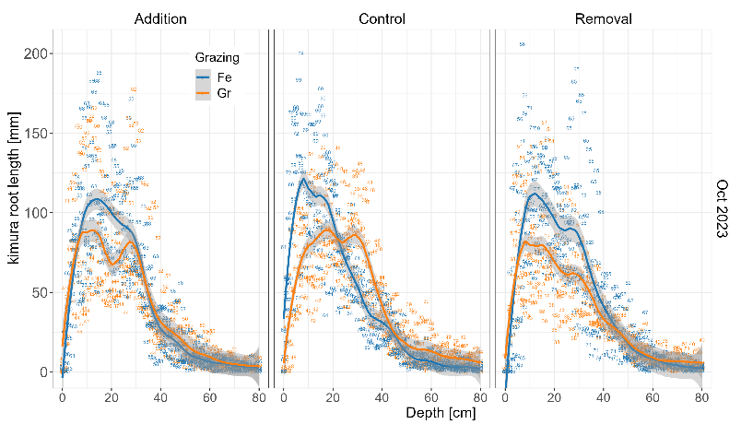
Continuous Depth Distribution

Slide 23
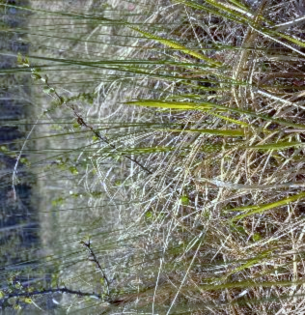
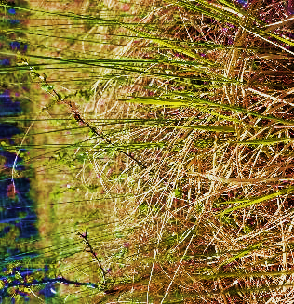
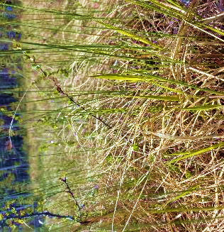
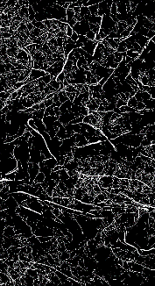
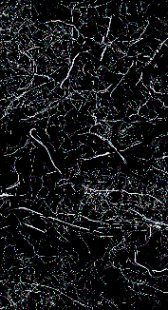

Above and Below are Temporally Linked

Slide 24
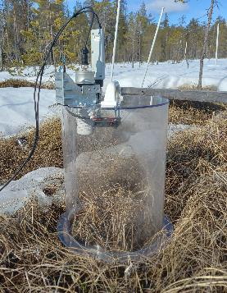
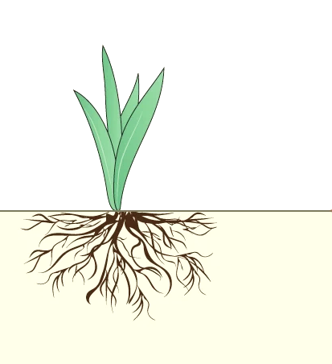
Spring Phenology (2023) 2024
(CH₄)
AG Growth
CO₂
BG Growth
Soil T
Modified: Blume-Werry 2022, Nature

Slide 25
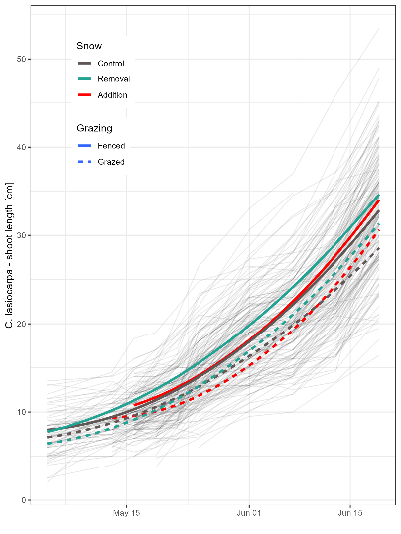
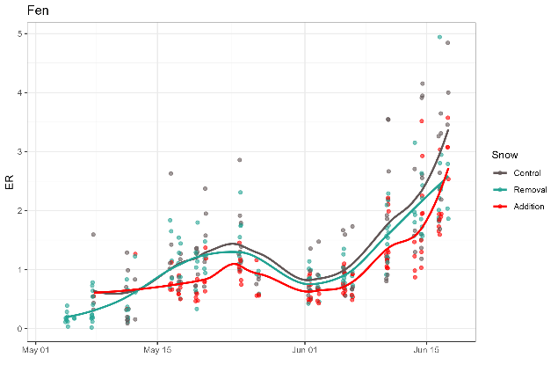
PhenoLink (2023)

Slide 26
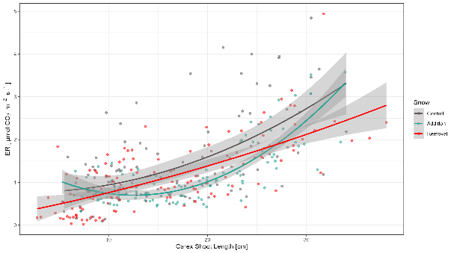
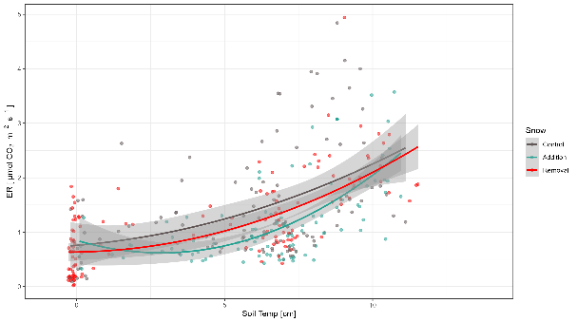
PhenoLink (2023)

Slide 27
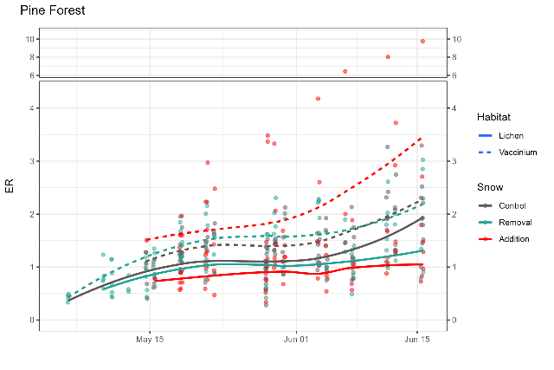
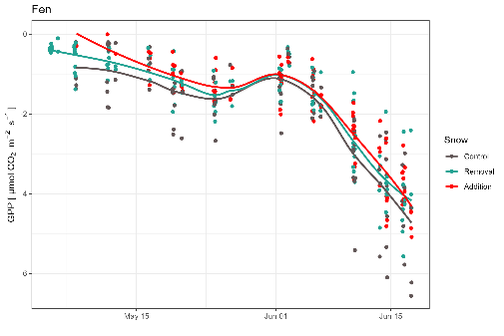

Slide 28
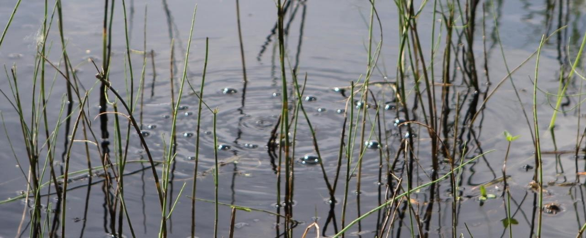
What about Methane?
Credit: NASA Kate Ramsayer, CC 2.0

Slide 29
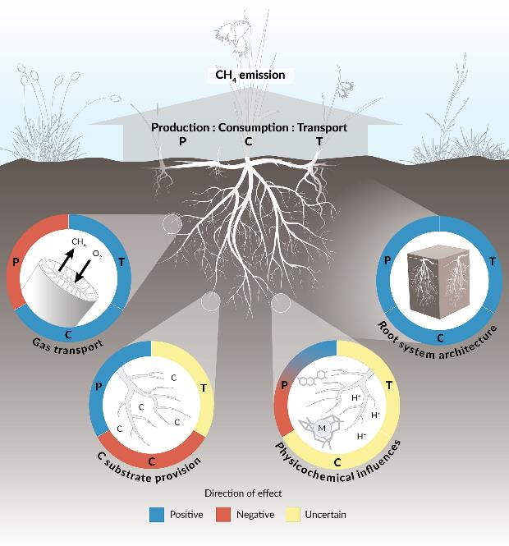
Roots & CH₄
Porewater CH4 is depth related
transport and consumption is root related
Role of old and new roots ?
Root exudates ?
Species?
Määttä & Malhotra 2024, Global Change Biology

Slide 30
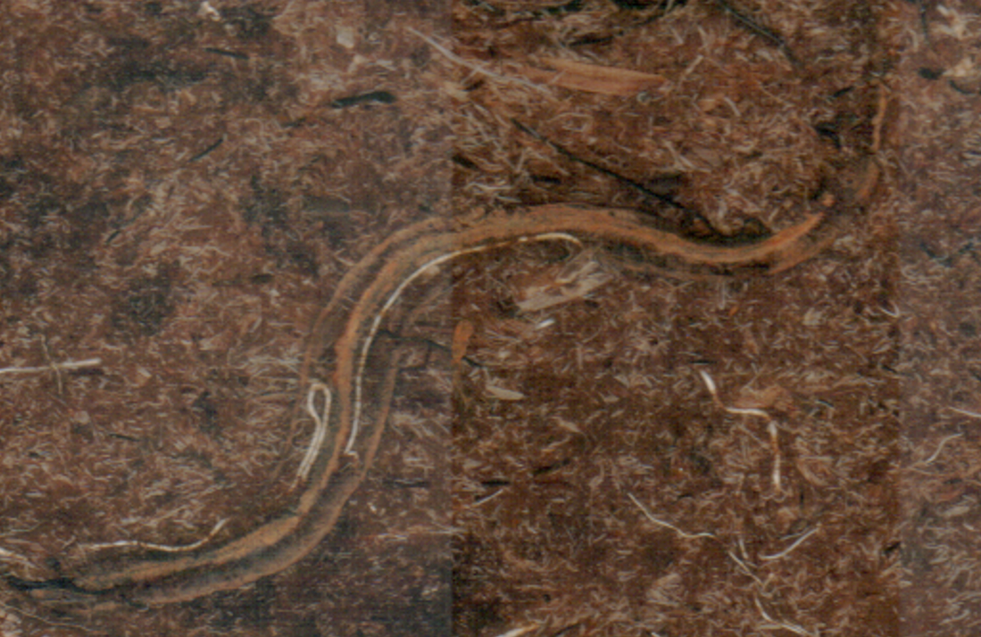
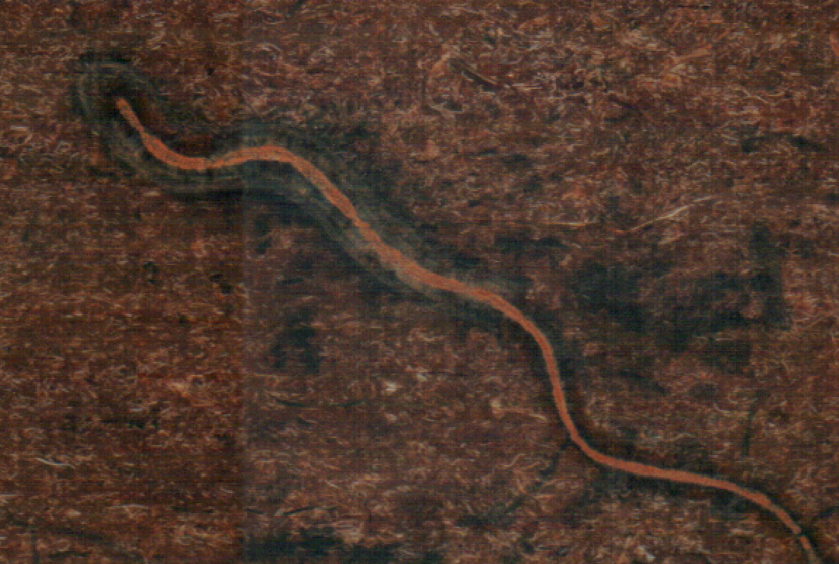
Deep Oxygen?

Slide 32
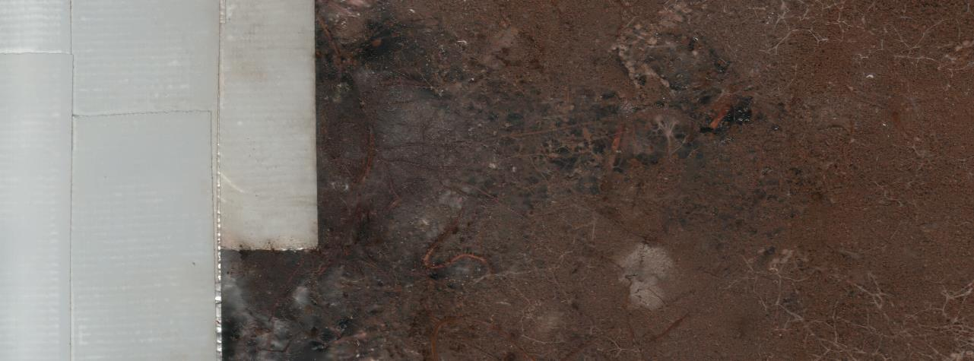
Soooo, are all roots the same - alike in growth and function?

Slide 33
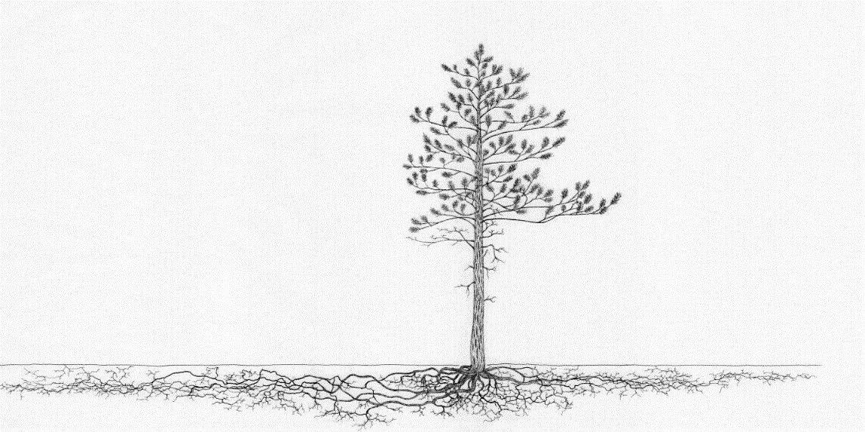
AG-BG Continuum
Stem Dendrometer
Minirhizotron
Root Dendrometer

Slide 34
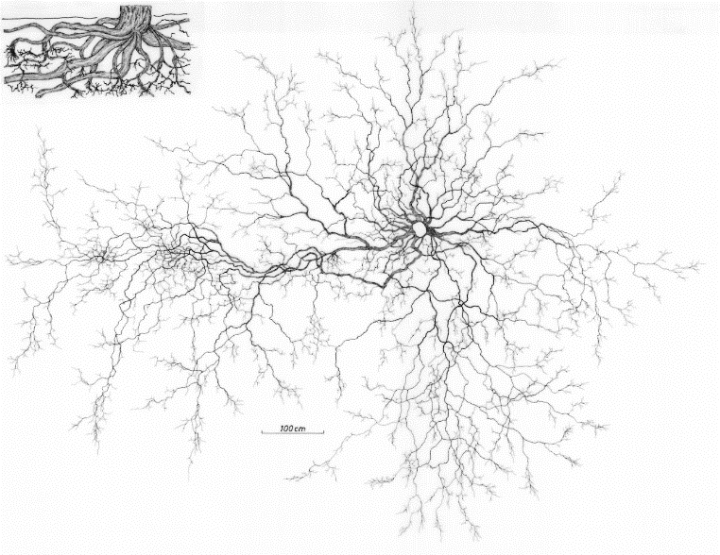

Slide 36
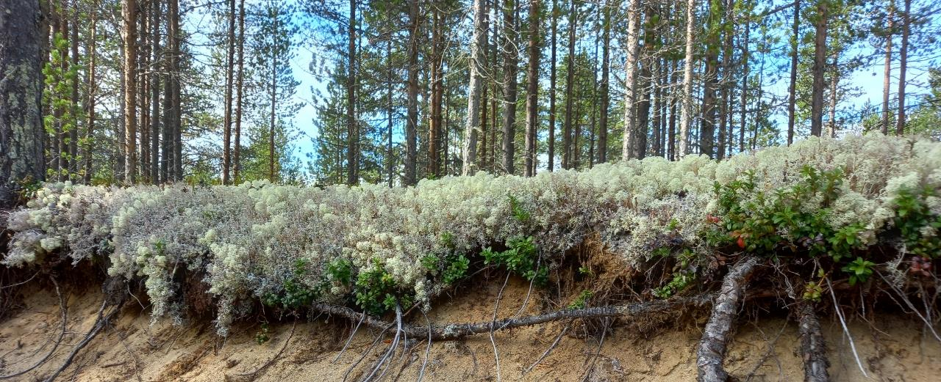
Thanks !!

Slide 37
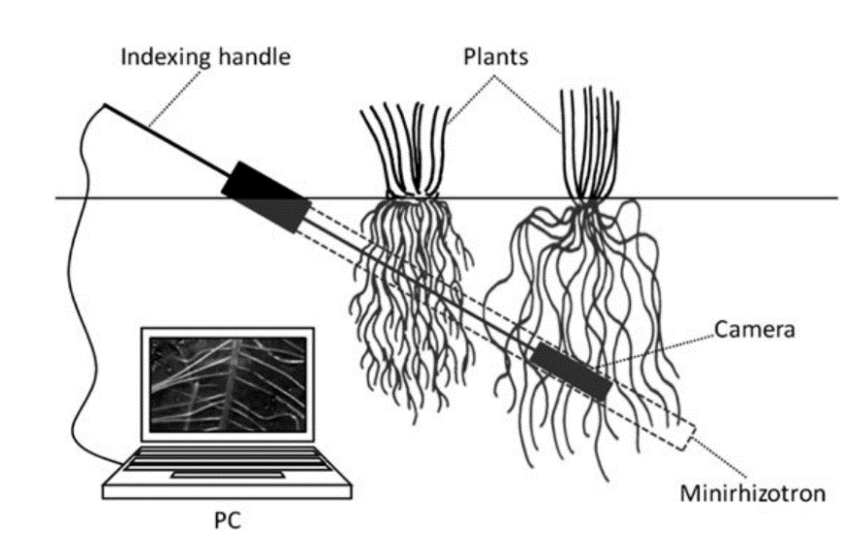
Your Equipment

Slide 38












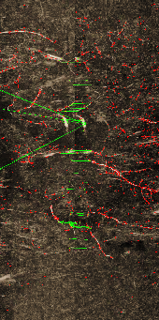

Key Feature Stitching
Step 2

